Slide 1

IOS Final Project Expense Tracker
Ellie Strande

Slide 2

User-centered design approach
Empathize: Who is the user?
Define: How is our app going to help/assist/support
Ideate: Scenarios or Storyboard + Wireframe
Prototype: Develop the app
Evaluate: Make sure that design heuristics apply

Slide 3
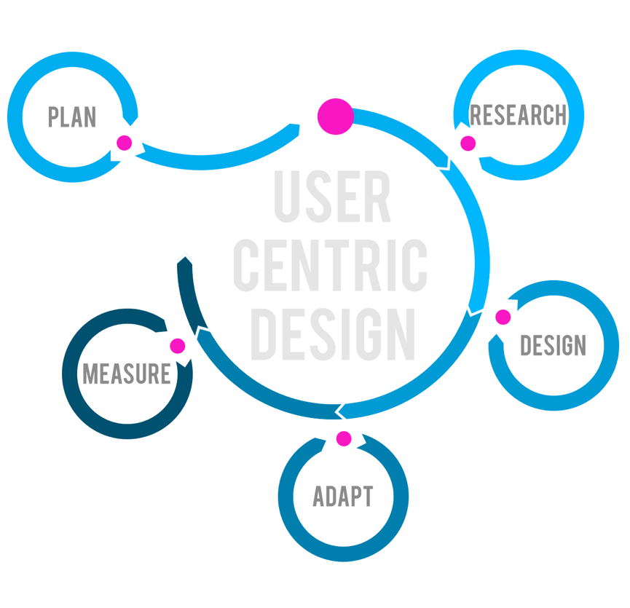
Empathize/Define
Who is the User?
An individual looking to track their monthly expenses
How is the app going to help/assist/support?
Going to help people create a more effective budget
Going to assist people in visualizing their post-expense income

Slide 4
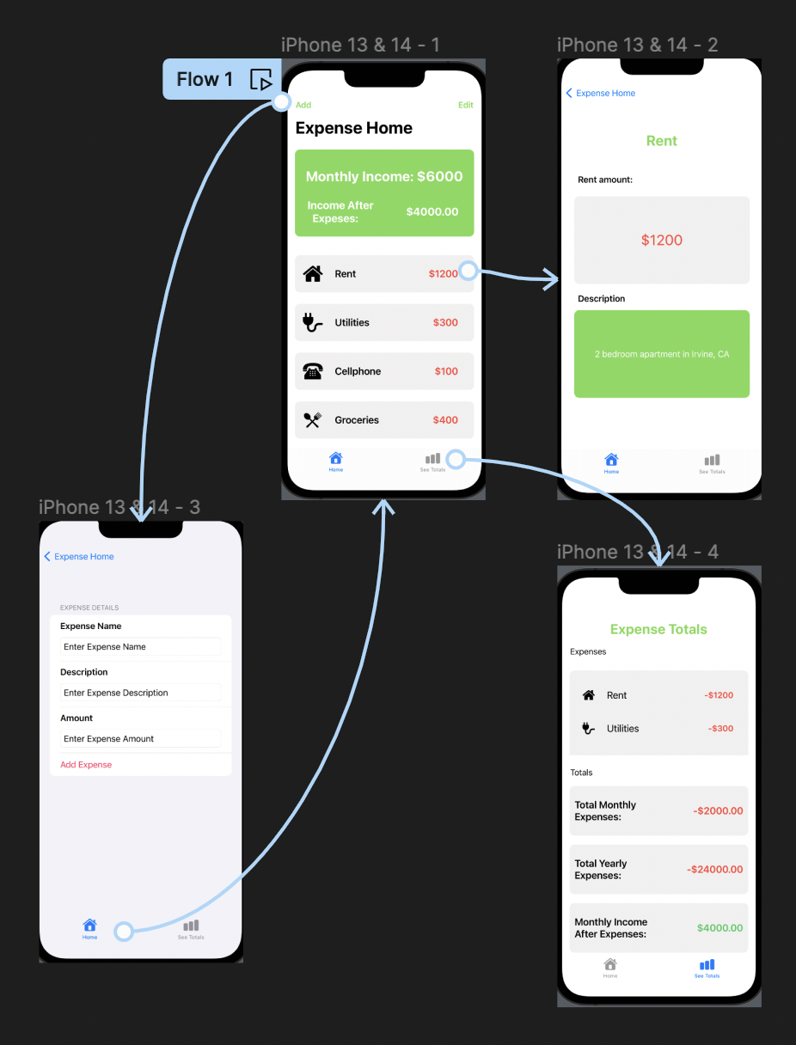
Ideate

Slide 5
Prototype

Slide 6
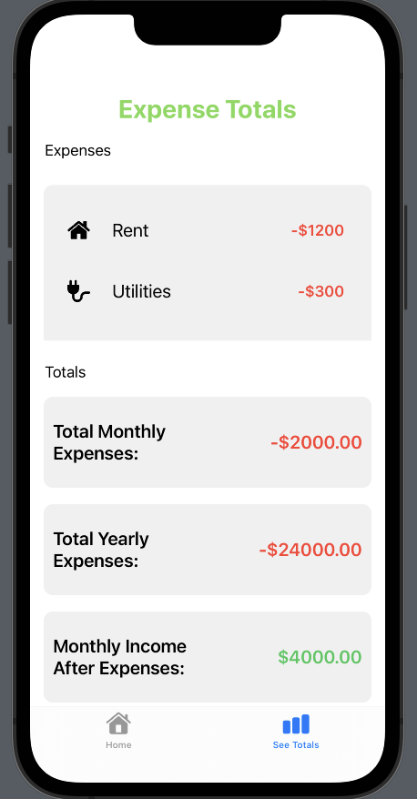
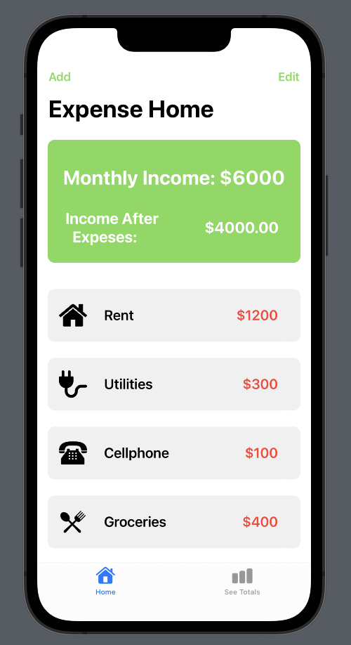
Evaluate: Two Design Heuristics
Match Between System and the Real World
Aesthetic and Minimalistic Design

Slide 7
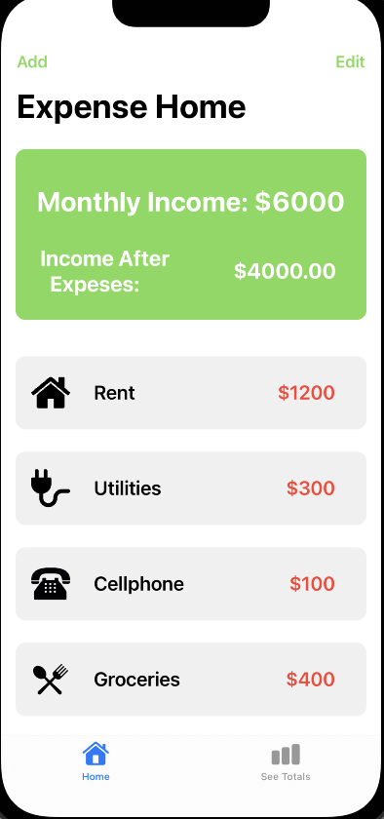
iOS Human Guideline #1: Tab Bar
Allows users to navigate between different sections of an app with easily a single tab
Ensures a more intuitive and efficient user experience
iOS Human Guideline #2: Clarity
Use of descriptive labels, intuitive icons, and concise language
Ensures that users can effortlessly understand and navigate the app’s interface
iOS Human Guideline #3: System Color (Green & Gray)
Provides a consistent and recognizable color scheme
Enhances user experience by ensuring visual coherence and accessibility

Slide 8
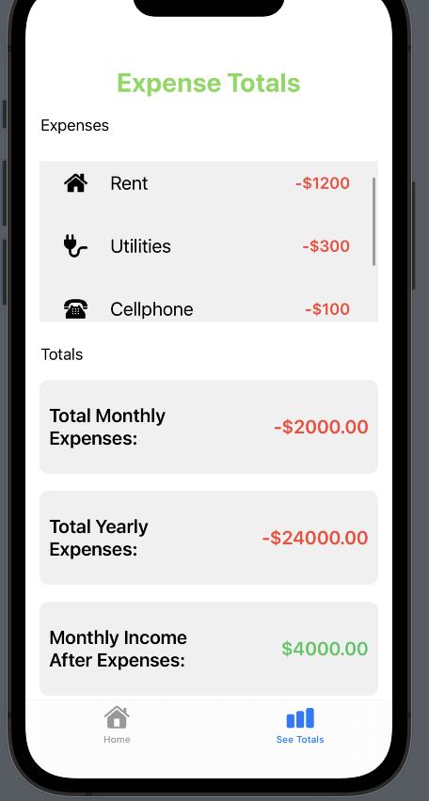
iOS Human Guideline #4: Direct Manipulation (Swiping & Tapping)
Leverages intuitive gestures that align with users’ natural interactions
Makes the app more user-friendly and engaging

Slide 9
Conclusion
Lessons Learned
Future Work
Limitations

